Slide 1
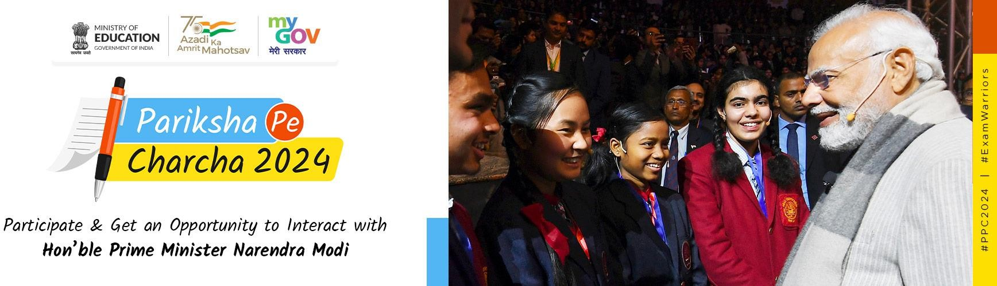
“Pariksha Pe Charcha 2025”

Slide 2

Steps for Registration

Slide 3
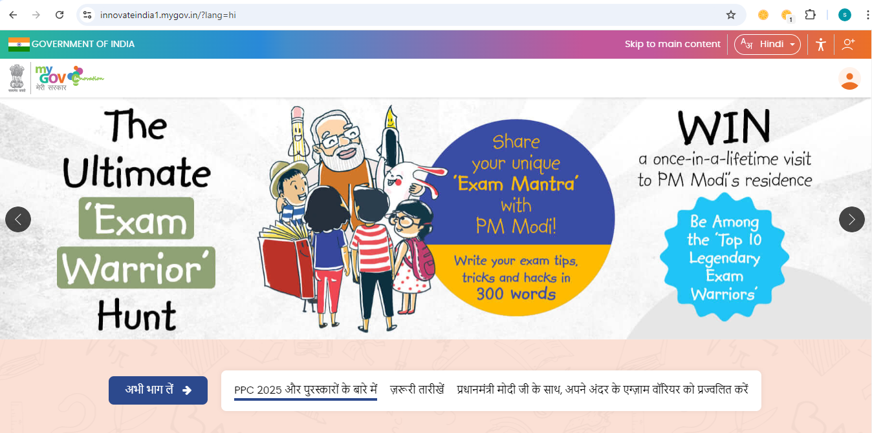
the initial step - to visit the official website
https://innovateindia1.mygov.in/

Slide 4
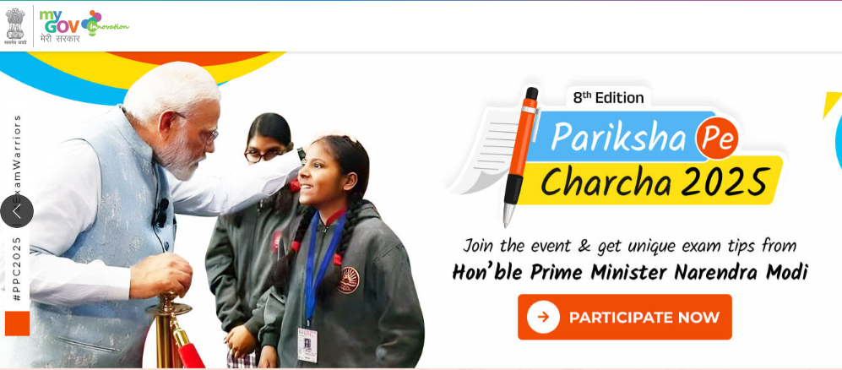
STEP 2: on the homepage, you will see a link ” participate now”.

Slide 5
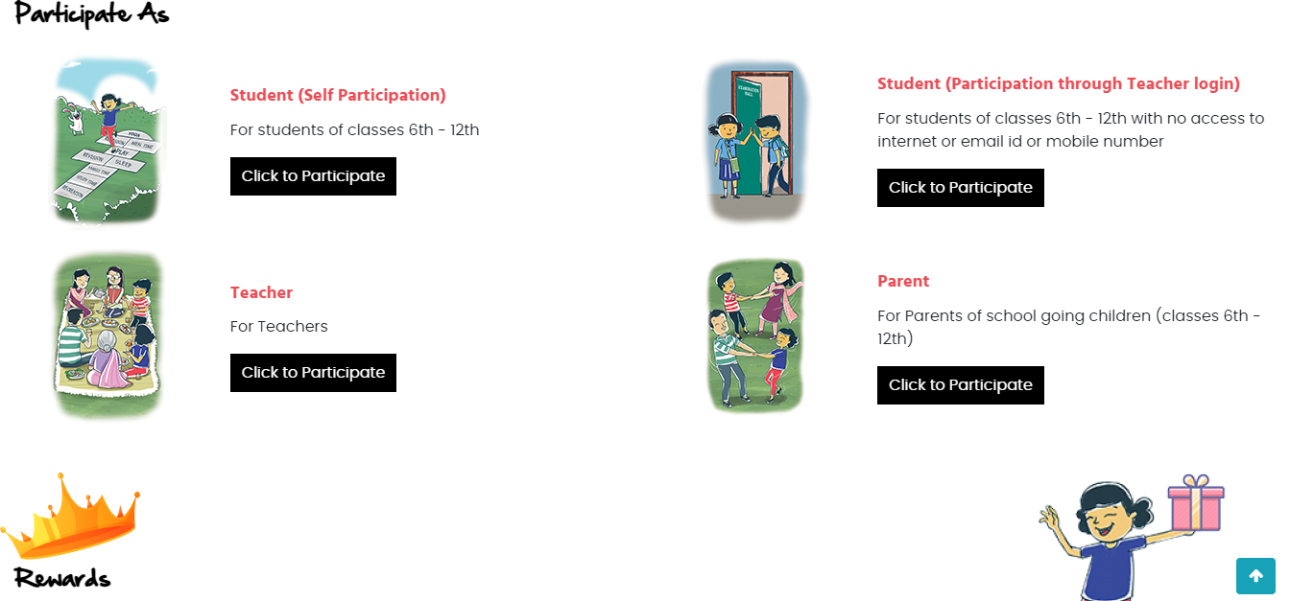
STEP 3: When you click on “Participate Now” then some options will open on your screen.
In options, you will see registration by Student (self), Student (Through Teacher), Teacher, and Parent.

Slide 6
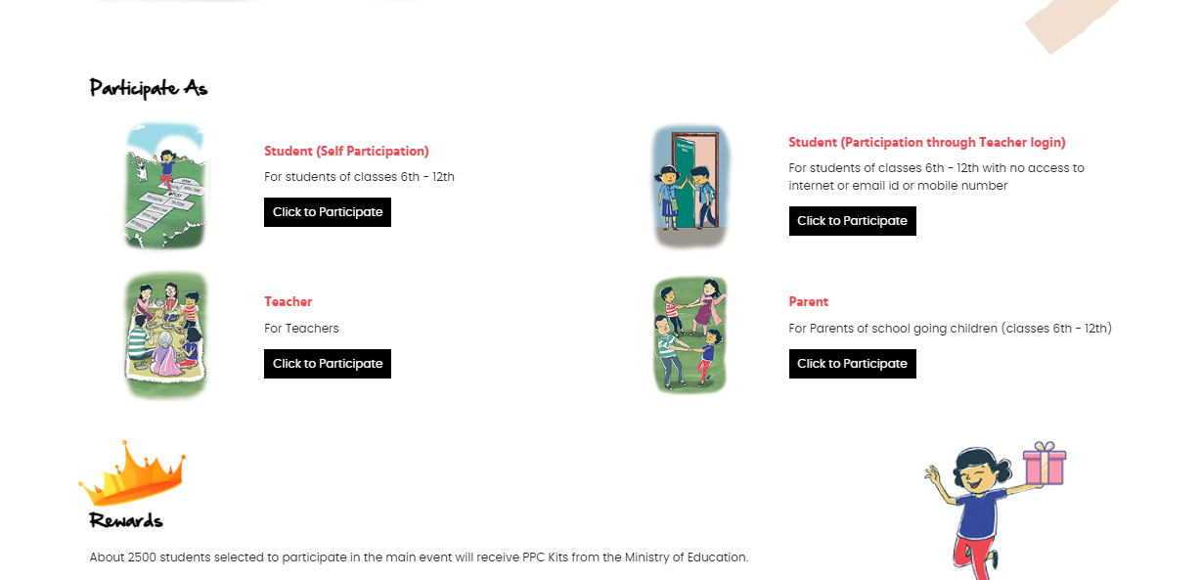
STEP 1: For Participating As a Student click on Student (Self Participation) – Click to Participate

Slide 7
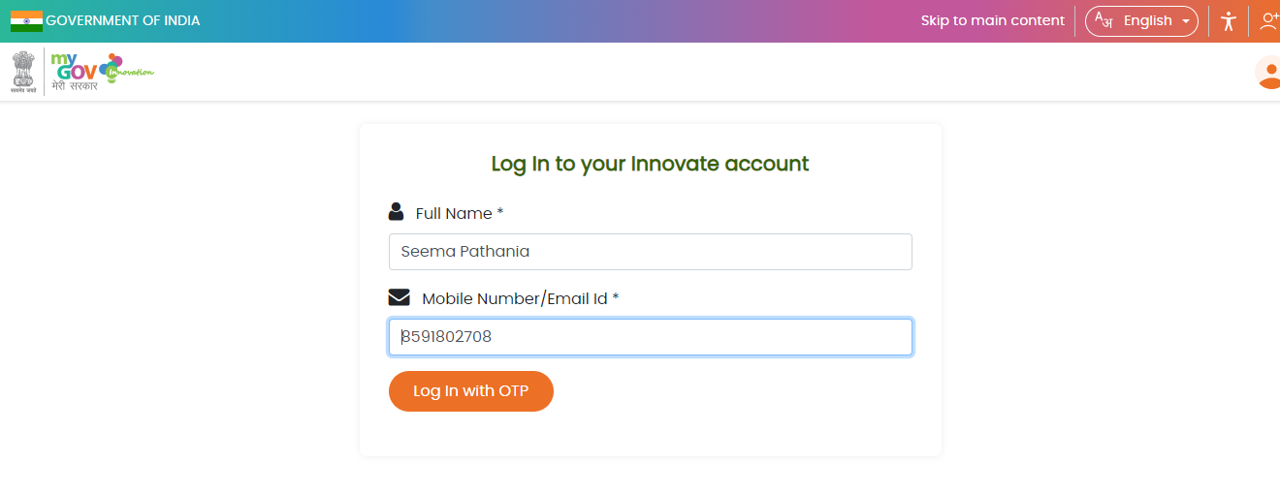
STEP 3: Enter your Full Name & Mobile No./ Email ID to login

Slide 8
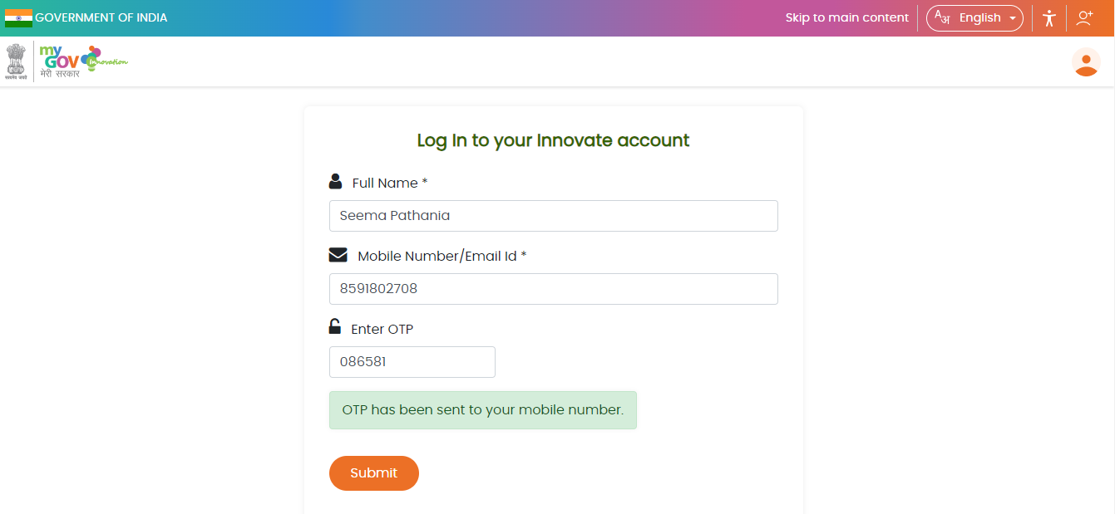
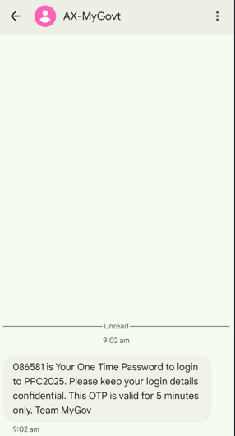
STEP 4: Enter the OTP which you will receive on your Mobile No or Email Id.

Slide 9
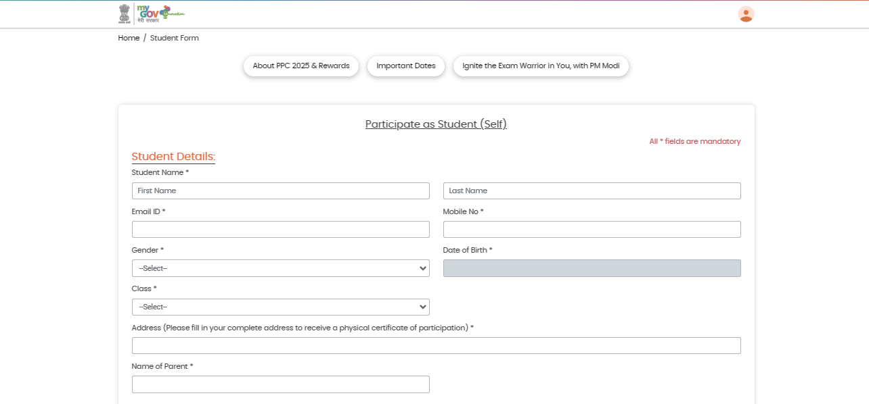
STEP 5: Enter the Student Details

Slide 10
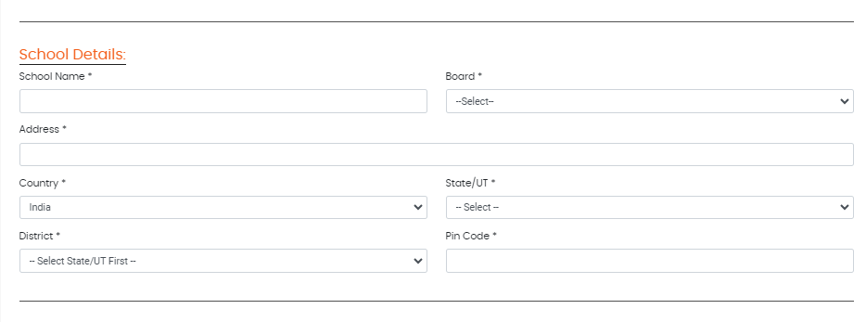
STEP 6: Fill in the School Details

Slide 11
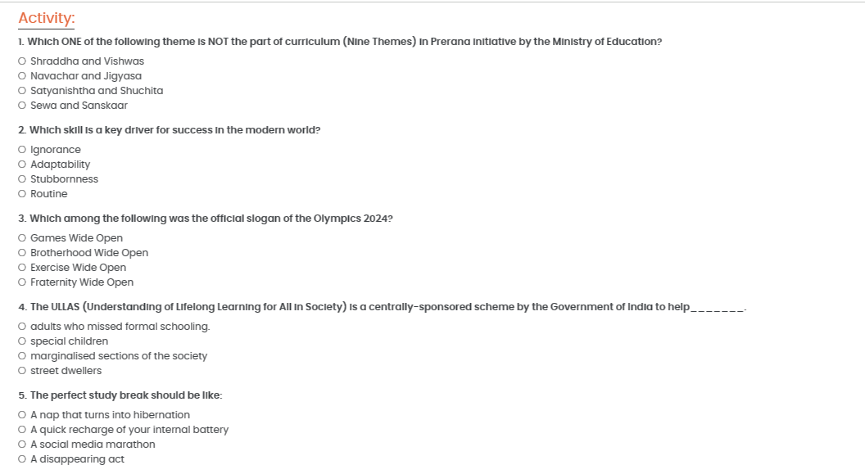
STEP 7: Fill the Response in the Activity.

Slide 12
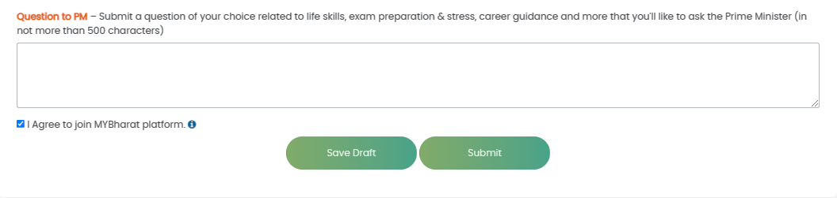
STEP 8: Submit a Question to Hon’ble PM

Slide 13
STEP 1: For participating as Teacher – Click to Participate

Slide 14
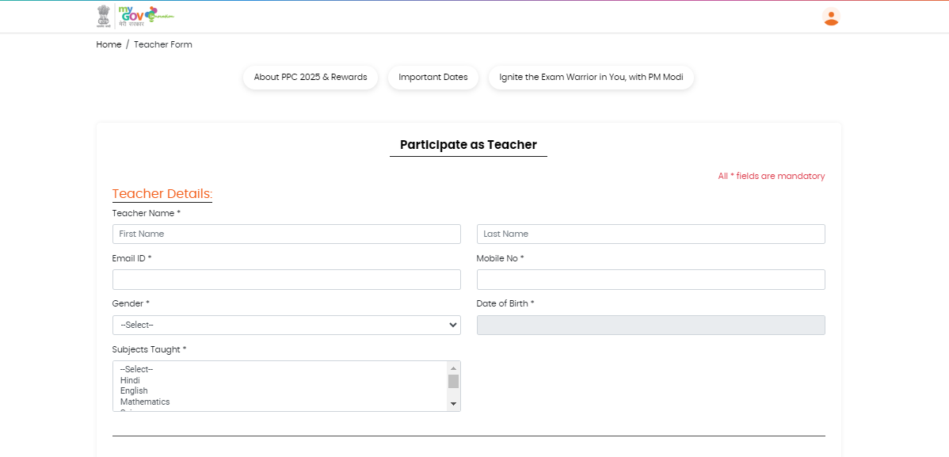
STEP 5: Enter The Teacher Details

Slide 15
STEP 6: Fill in the School Details

Slide 16
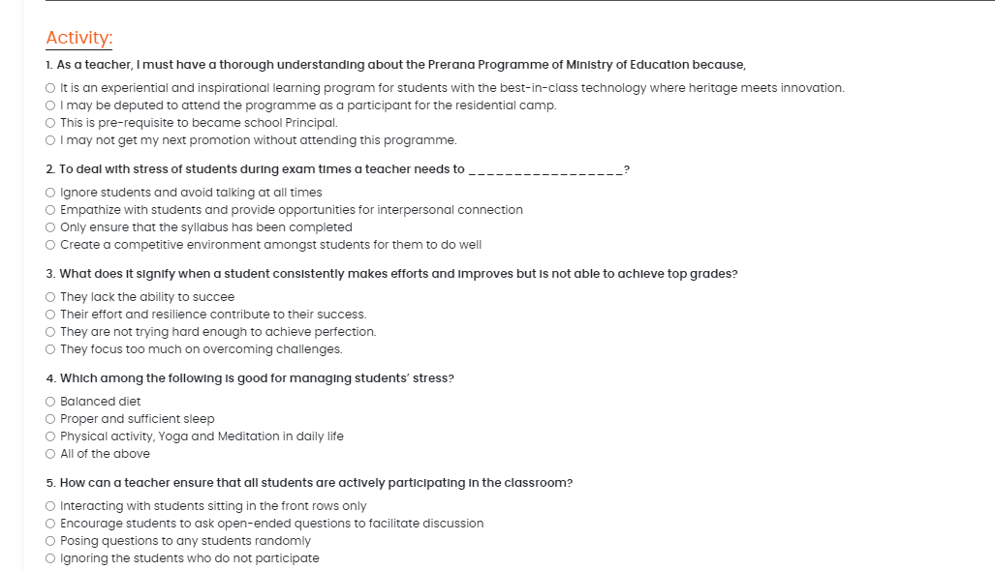
STEP 7: Fill the response in the Activity.

Slide 17
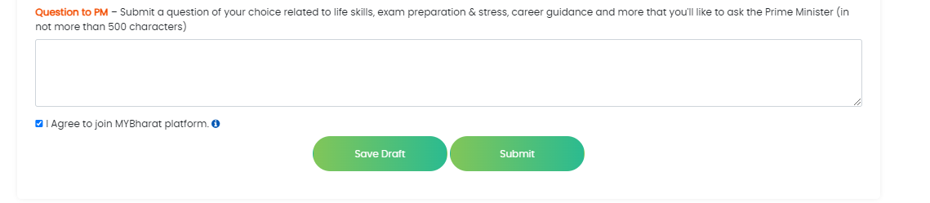
STEP 8: Submit a Question to Hon’ble PM

Slide 18
STEP 1: For Parent Participation : – Click to participate

Slide 19
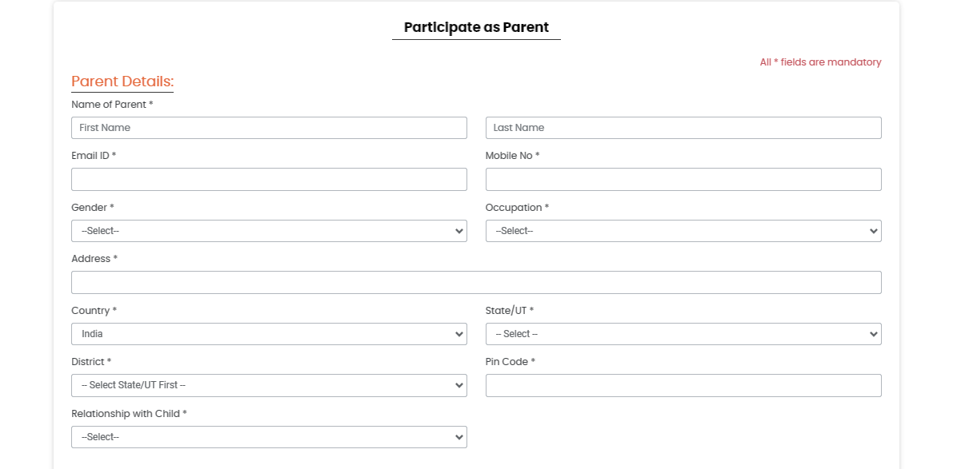
STEP 5: Enter the Parent Details

Slide 20
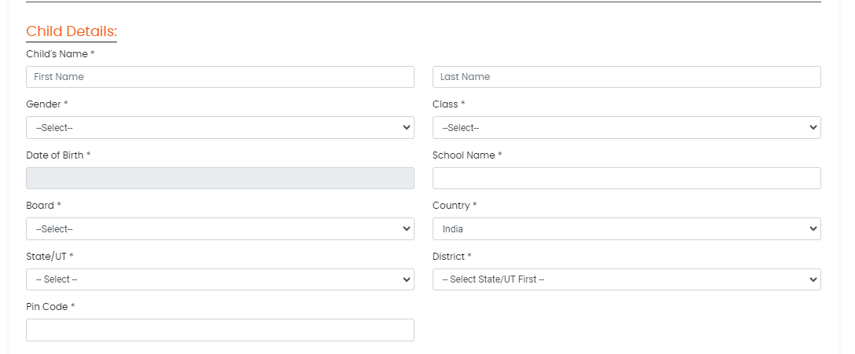
STEP 6: Fill in the Child Details

Slide 21
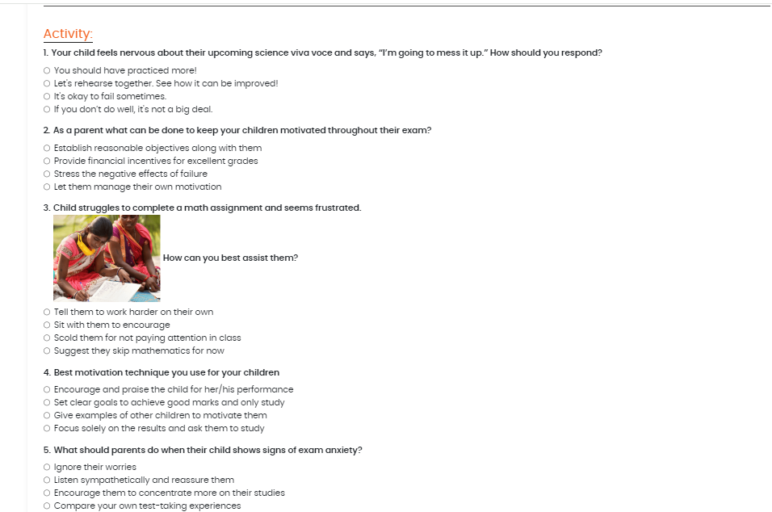
STEP 7: Fill the response in the Activity.

Slide 22
STEP 1: For Student (Participation through Teacher login): – Click to participate

Slide 23
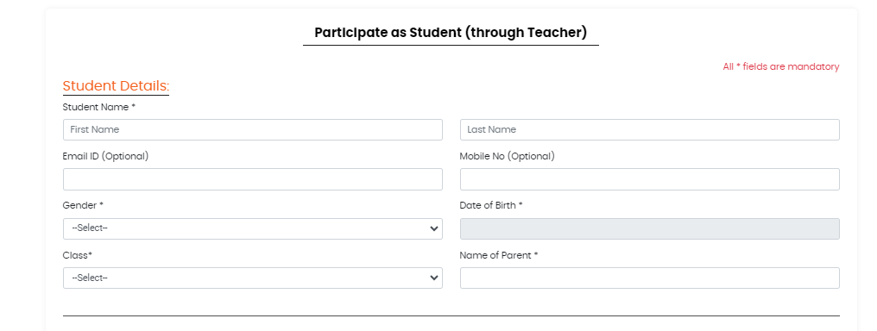
STEP 5: Enter The Student Details (Through Teacher)

Slide 24
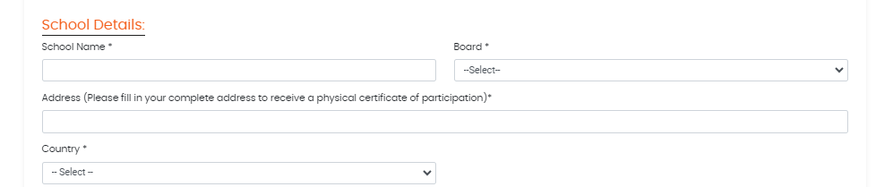
STEP 6: Fill in the School Details

Slide 25
STEP 7: Fill the response in the Activity.

Slide 26
STEP 8: Submit a Question to Hon’ble PM

Slide 27
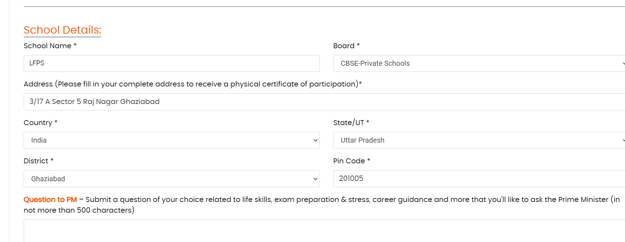
No need to resubmit the school details if registering student through teacher login

Slide 28


